Slide 1
BMD ENG 301Quantitative Systems Physiology (Nervous System)
Lecture 13: Metabotropic receptors continued,
+ Synaptic Plasticity
2022_v1
Professor Malcolm MacIver

Slide 2
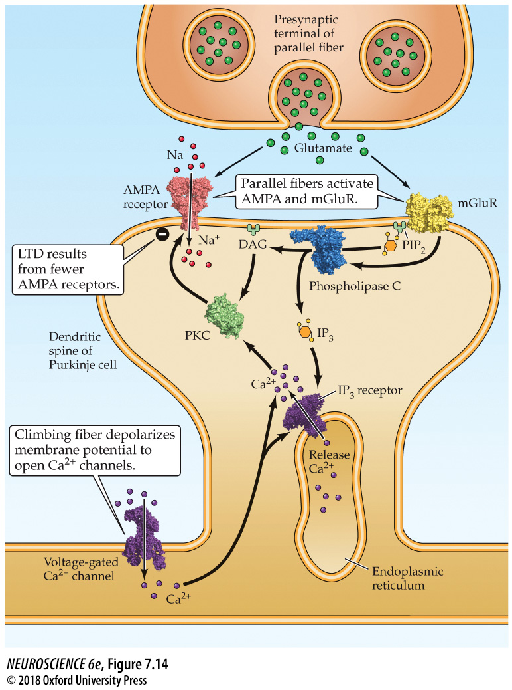
Signaling at cerebellar parallel fiber synapses during long-term synaptic depression
Notes:
FIGURE 7.14 Signaling at cerebellar parallel fiber synapses during long-term synaptic depression. Glutamate released by parallel fibers activates both AMPA-type and metabotropic receptors. The latter produce IP₃ and DAG in the Purkinje cell. When paired with a rise in Ca²⁺ associated with activity of climbing fiber synapses, the IP₃ causes Ca²⁺ to be released from the endoplasmic reticulum, while Ca²⁺ and DAG together activate protein kinase C. These signals together change the properties of AMPA receptors to produce long-term depression.

Slide 3
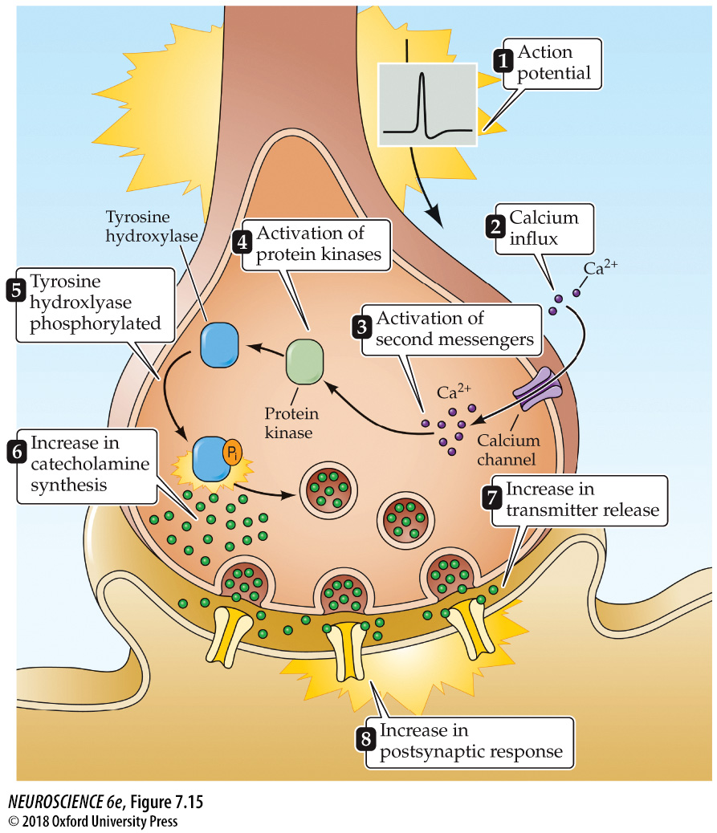
Regulation of tyrosine hydroxylase by protein phosphorylation
Tetanic
stimulation
resulting in
persistent
calcium
increase and
tyrosine hydroxylase
increase
Notes:
FIGURE 7.15 Regulation of tyrosine hydroxylase by protein phosphorylation. Tyrosine hydroxylase governs the synthesis of the catecholamine neurotransmitters and is stimulated by several intracellular signals. In the example shown here, neuronal electrical activity (1) causes influx of Ca²⁺ (2). The resultant rise in intracellular Ca²⁺ concentration (3) activates protein kinases (4), which phosphorylates tyrosine hydroxylase (5), stimulating catecholamine synthesis (6). This increased synthesis in turn increases the release of catecholamines (7) and enhances the postsynaptic response produced by the synapse (8).

Slide 4
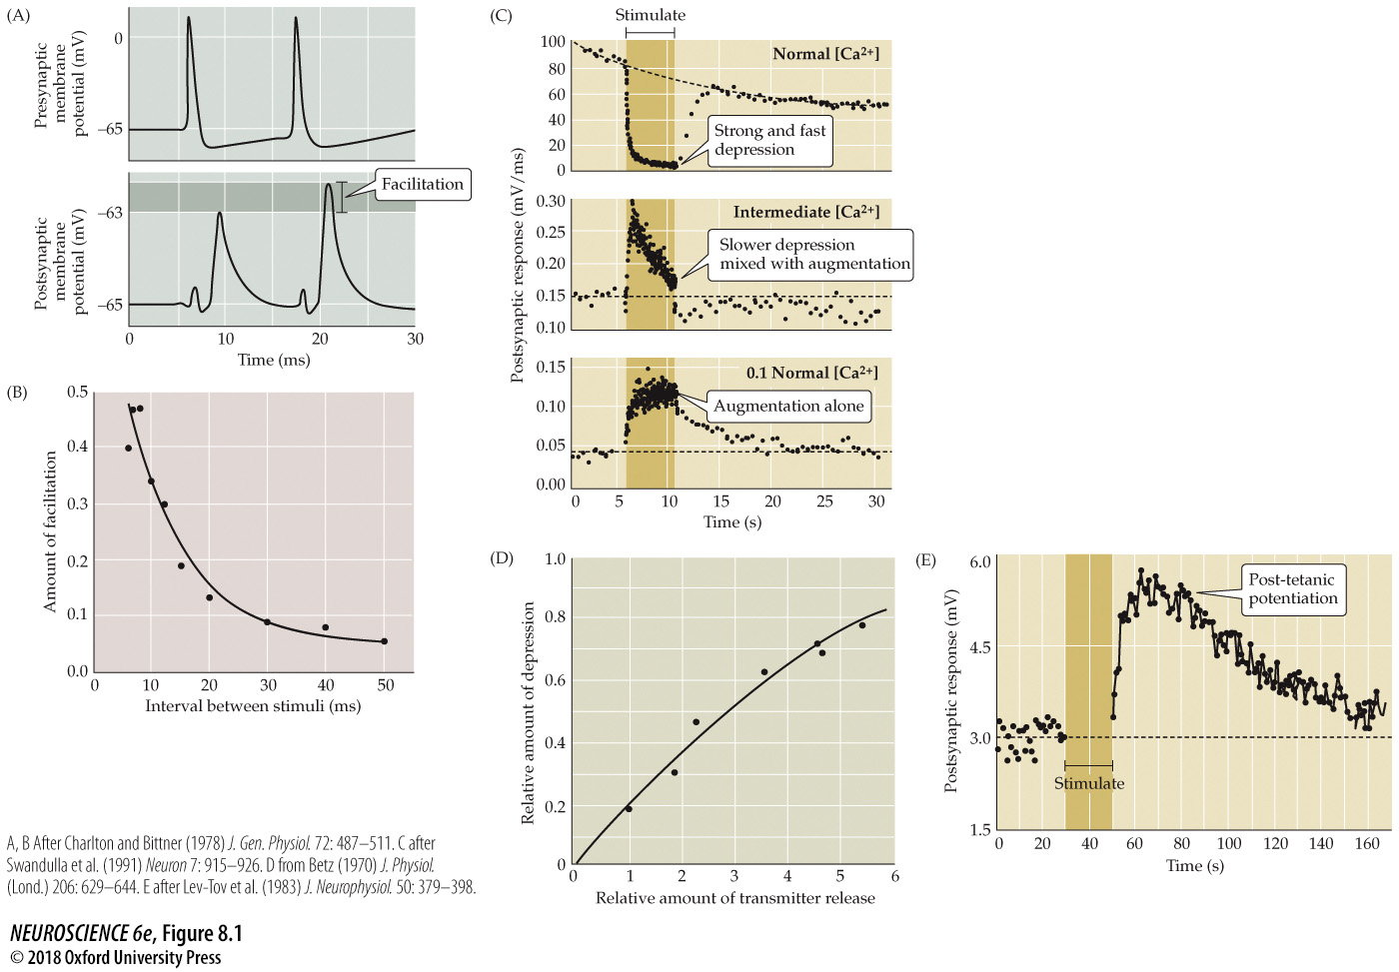
Forms of short-term synaptic plasticity
Modulation of NT release
[Ca²⁺]_{INSIDE}
Vesicle depletion
Notes:
FIGURE 8.1 Forms of short-term synaptic plasticity. (A) Facilitation at the squid giant synapse. A pair of presynaptic action potentials elicits two excitatory postsynaptic potentials (EPSPs). Because of facilitation, the second EPSP is larger than the first. (B) By varying the time interval between pairs of presynaptic action potentials, it can be seen that facilitation decays over a time course of tens of milliseconds. (C) Under typical physiological conditions, a high-frequency tetanus (darker bar) causes pronounced depression of EPSPs at the squid giant synapse (top). Lowering the external Ca²⁺ concentration to an intermediate level reduces transmitter release and causes a mixture of depression and augmentation (middle). Further reduction of the external Ca²⁺ eliminates depression, leaving only augmentation (bottom). (D) Synaptic depression at the frog neuromuscular synapse increases in proportion to the amount of transmitter released from the presynaptic terminal. (E) Application of a high-frequency tetanus (bar) to presynaptic axons innervating a spinal motor neuron causes a post-tetanic potentiation that persists for a few minutes after the tetanus ends. (A,B after Charlton and Bittner, 1978; C after Swandulla et al., 1991; D from Betz, 1970; E after Lev-Tov et al., 1983.)

Slide 5
Regulation of tyrosine hydroxylase by protein phosphorylation
Notes:
FIGURE 7.15 Regulation of tyrosine hydroxylase by protein phosphorylation. Tyrosine hydroxylase governs the synthesis of the catecholamine neurotransmitters and is stimulated by several intracellular signals. In the example shown here, neuronal electrical activity (1) causes influx of Ca²⁺ (2). The resultant rise in intracellular Ca²⁺ concentration (3) activates protein kinases (4), which phosphorylates tyrosine hydroxylase (5), stimulating catecholamine synthesis (6). This increased synthesis in turn increases the release of catecholamines (7) and enhances the postsynaptic response produced by the synapse (8).

Slide 6
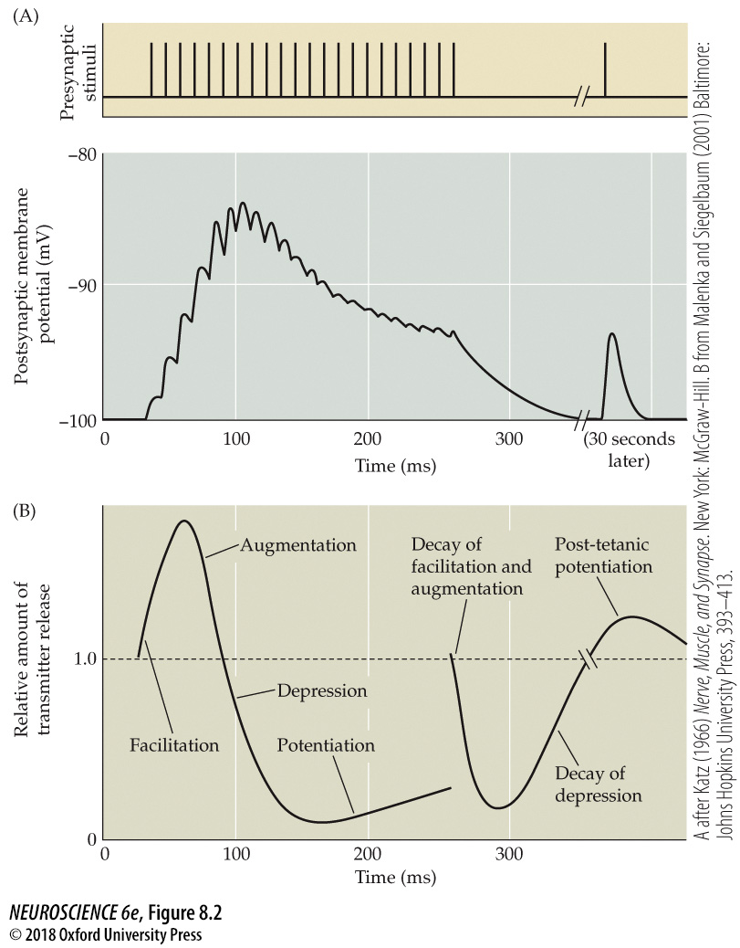
Short-term plasticity at the neuromuscular synapse
Notes:
FIGURE 8.2 Short-term plasticity at the neuromuscular synapse. (A) A train of electrical stimuli (top) applied to the presynaptic motor nerve produces changes in the end plate potential (EPP) amplitude (bottom). (B) Dynamic changes in transmitter release caused by the interplay of several forms of short-term plasticity. Facilitation and augmentation of the EPP occurs at the beginning of the stimulus train and are followed by a pronounced depression of the EPP. Potentiation begins late in the stimulus train and persists for many seconds after the end of the stimulus, leading to post-tetanic potentiation. (A after Katz, 1966; B after Malenka and Siegelbaum, 2001.)

Slide 7
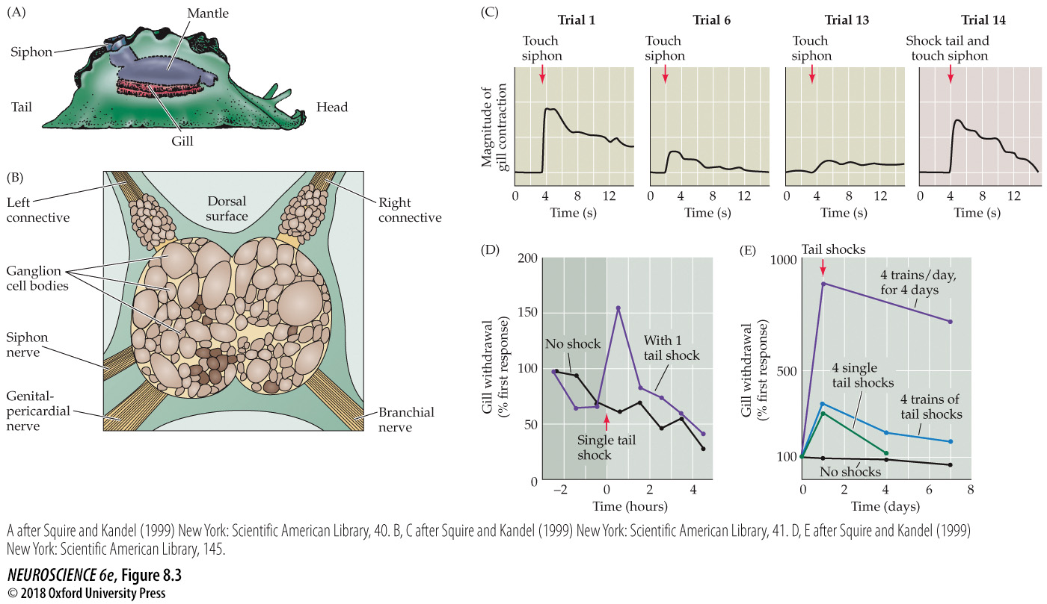
Short-term sensitization of the Aplysia gill withdrawal reflex
Notes:
FIGURE 8.3 Short-term sensitization of the Aplysia gill withdrawal reflex. (A) Drawing of an Aplysia (commonly known as the sea slug). (B) The abdominal ganglion of Aplysia. The cell bodies of many of the neurons involved in gill withdrawal can be recognized by their size, shape, and position within this ganglion. (C) Changes in the gill withdrawal behavior due to habituation and sensitization. The first time the siphon is touched, the gill contracts vigorously. Repeated touches elicit smaller gill contractions due to habituation. Subsequently pairing a siphon touch with an electrical shock to the tail restores a large and rapid gill contraction, the result of short-term sensitization. (D) Time course of short-term sensitization of the gill withdrawal response following the pairing of a single tail shock with a siphon touch. (E) Repeated applications of tail shocks cause prolonged sensitization of the gill withdrawal response. (After Squire and Kandel, 1999.)

Slide 8
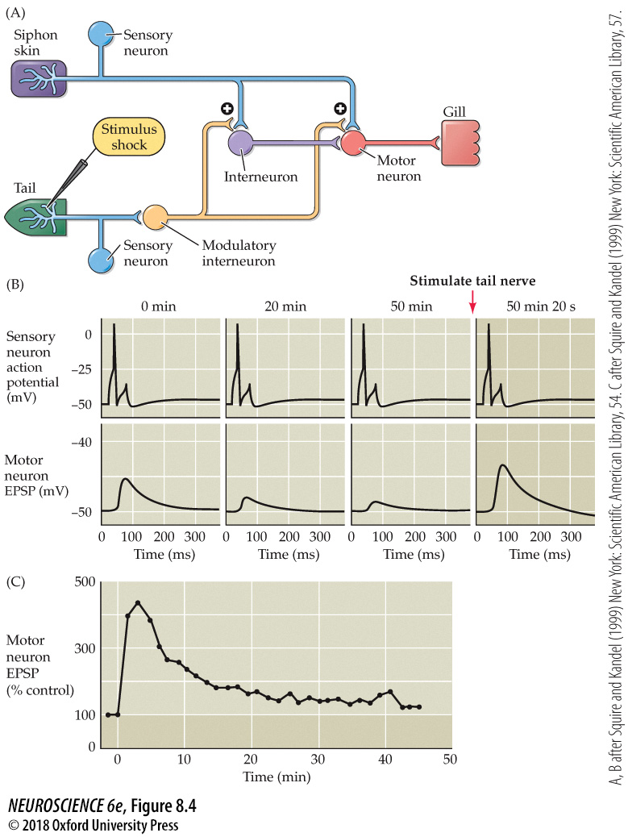
Synaptic mechanisms underlying short-term sensitization
Notes:
FIGURE 8.4 Synaptic mechanisms underlying short-term sensitization. (A) Neural circuitry involved in sensitization. Touching the siphon skin activates sensory neurons that excite interneurons and gill motor neurons, yielding a contraction of the gill muscle. A shock to the animal’s tail stimulates modulatory interneurons that alter synaptic transmission between the siphon sensory neurons and gill motor neurons, resulting in sensitization. (B) Changes in synaptic efficacy at the sensory neuron–motor neuron synapse during short-term sensitization. Prior to sensitization, activating the siphon sensory neurons causes an EPSP to occur in the gill motor neurons. Repetitive activation of this synapse causes synaptic depression, indicated by a reduction in EPSPs in motor neurons. Activation of the serotonergic modulatory interneurons enhances release of transmitter from the sensory neurons onto the motor neurons, increasing the EPSP in the motor neurons and causing the motor neurons to more strongly excite the gill muscle. (C) Time course of the serotonin-induced facilitation of transmission at the sensory–motor synapse. (After Squire and Kandel, 1999.)

Slide 9
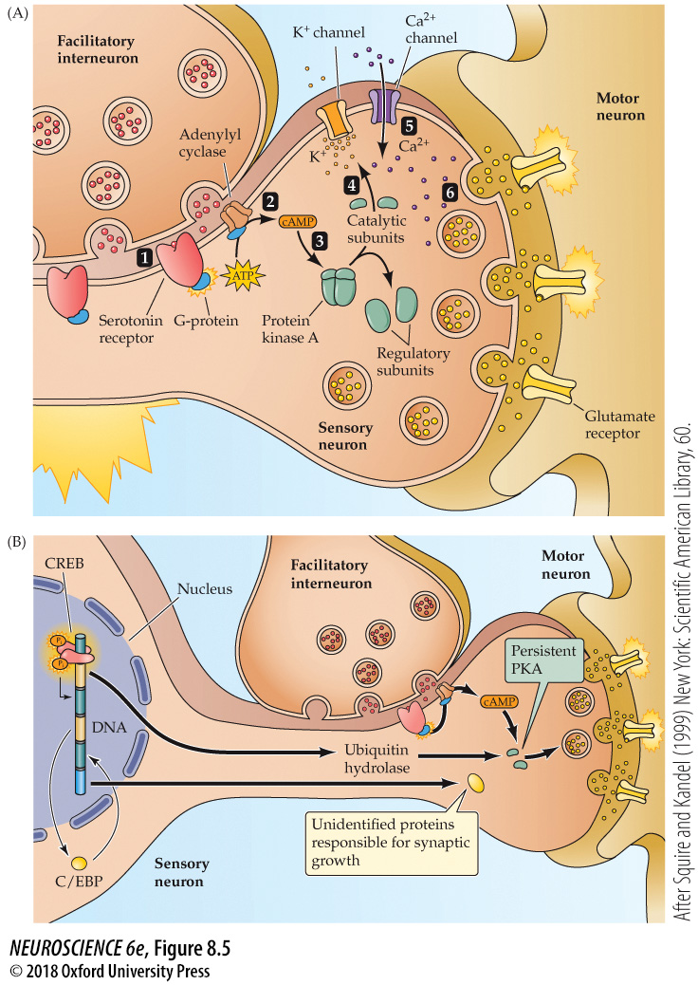
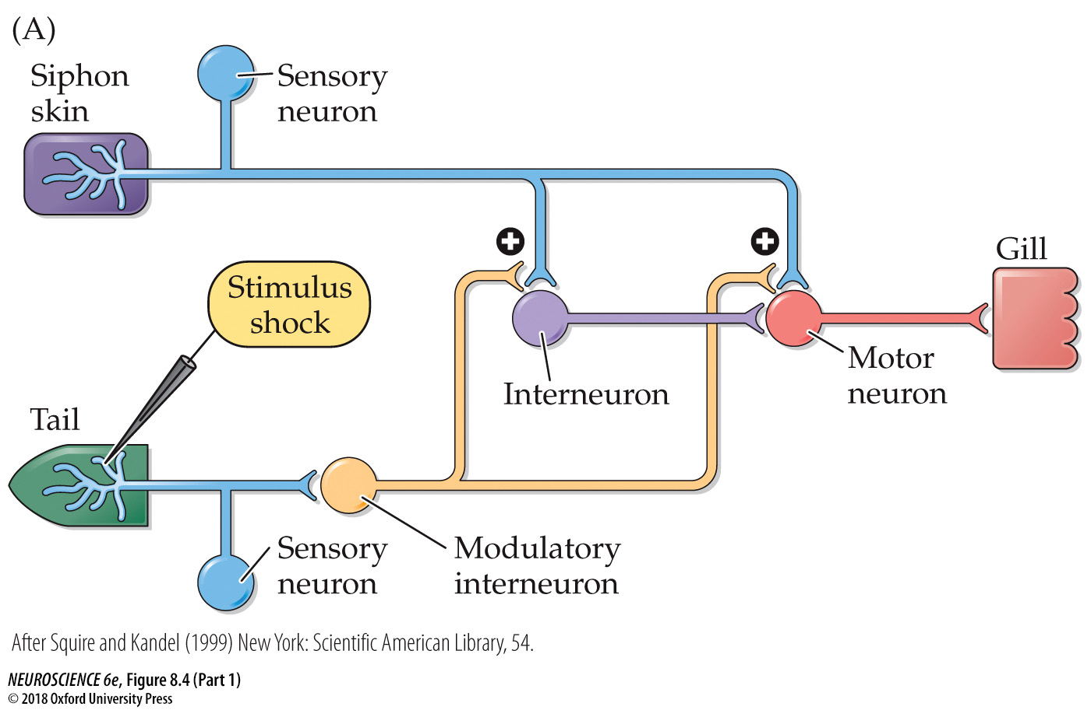
Mechanisms of presynaptic enhancement underlying behavioral sensitization
Short and long term effects
Notes:
FIGURE 8.5 Mechanisms of presynaptic enhancement underlying behavioral sensitization. (A) Short-term sensitization is due to an acute, PKA-dependent enhancement of glutamate release from the presynaptic terminals of sensory neurons. See text for explanation. (B) Long-term sensitization is due to changes in gene expression, resulting in the synthesis of proteins that change PKA activity and lead to changes in synapse growth. (After Squire and Kandel, 1999.)

Slide 10
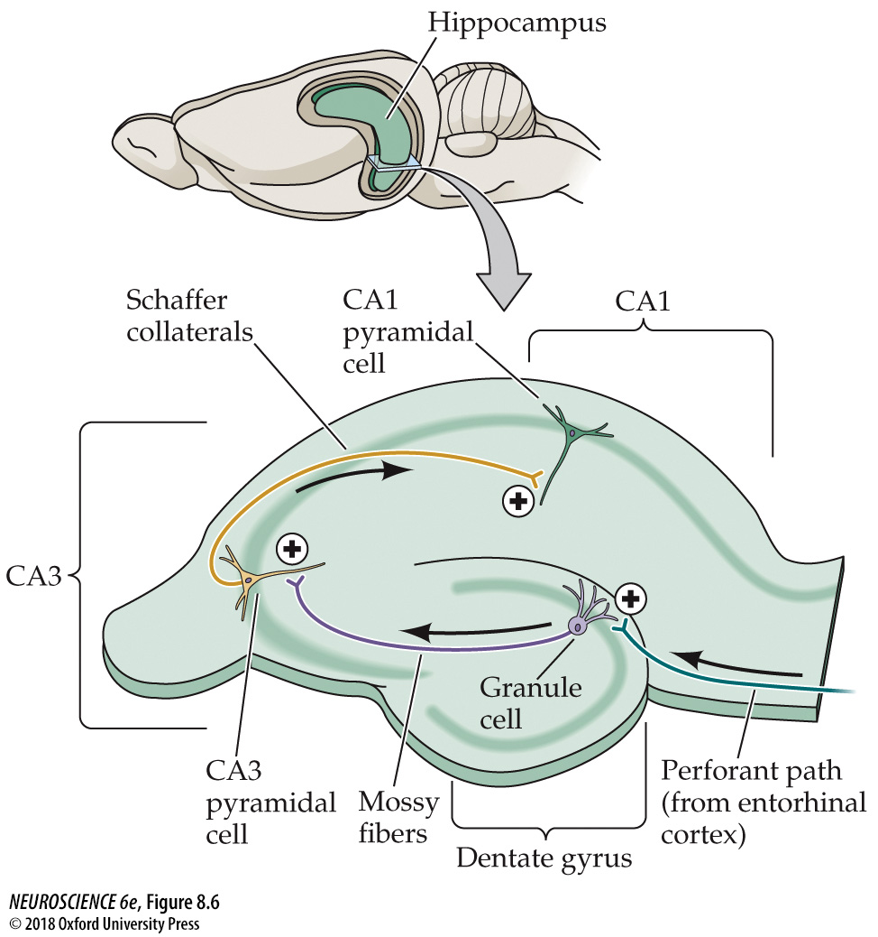
The trisynaptic circuit of the hippocampus
Notes:
FIGURE 8.6 The trisynaptic circuit of the hippocampus. A section through the rodent hippocampus diagrams excitatory pathways and synaptic connections. Long-term potentiation (plus signs) has been observed at each of the three synaptic connections shown here.

Slide 11
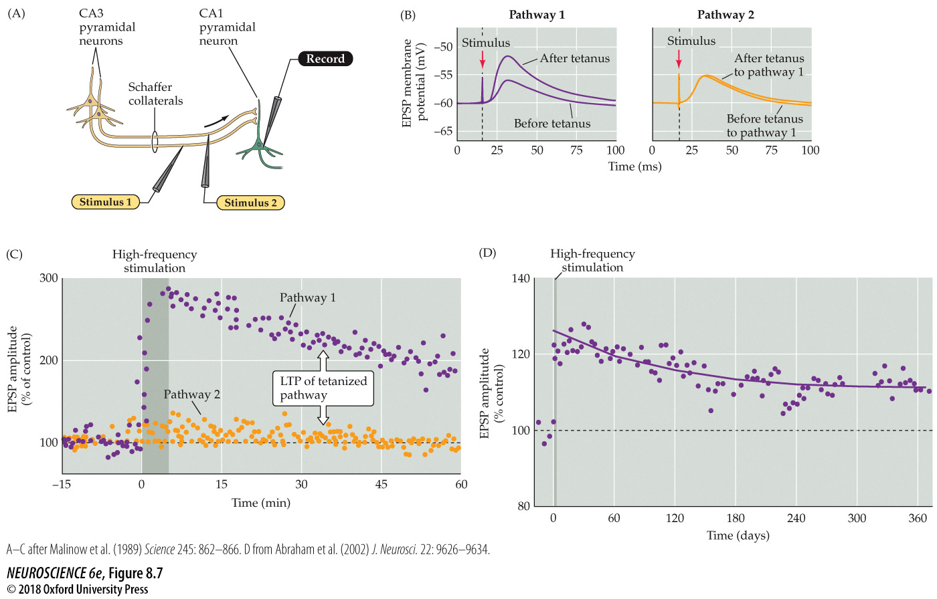
LTP of Schaffer collateral–CA1 synapses
Notes:
FIGURE 8.7 LTP of Schaffer collateral–CA1 synapses. (A) Arrangement for recording synaptic transmission. Two stimulating electrodes (1 and 2) activate separate populations of Schaffer collaterals, providing test and control synaptic pathways. (B) Left: Synaptic responses recorded in a CA1 neuron in response to single stimuli of synaptic pathway 1, minutes before and 1 hour after a high-frequency train of stimuli. The high-frequency stimulus train increases the size of the EPSP evoked by a single stimulus. Right: The size of the EPSP produced by stimulating synaptic pathway 2, which did not receive high-frequency stimulation, is unchanged. (C) Time course of changes in the amplitude of EPSPs evoked by stimulation of pathways 1 and 2. High-frequency stimulation of pathway 1 (darker bar) enhances EPSPs in this pathway (purple dots). This LTP of synaptic transmission in pathway 1 persists for more than an hour, while the amplitude of EPSPs produced by pathway 2 (orange dots) remains constant. (D) Recordings of EPSPs from the hippocampus in vivo reveal that high-frequency stimulation can produce LTP that lasts for more than 1 year. (A–C after Malinow et al., 1989; D from Abraham et al., 2002.)

Slide 12
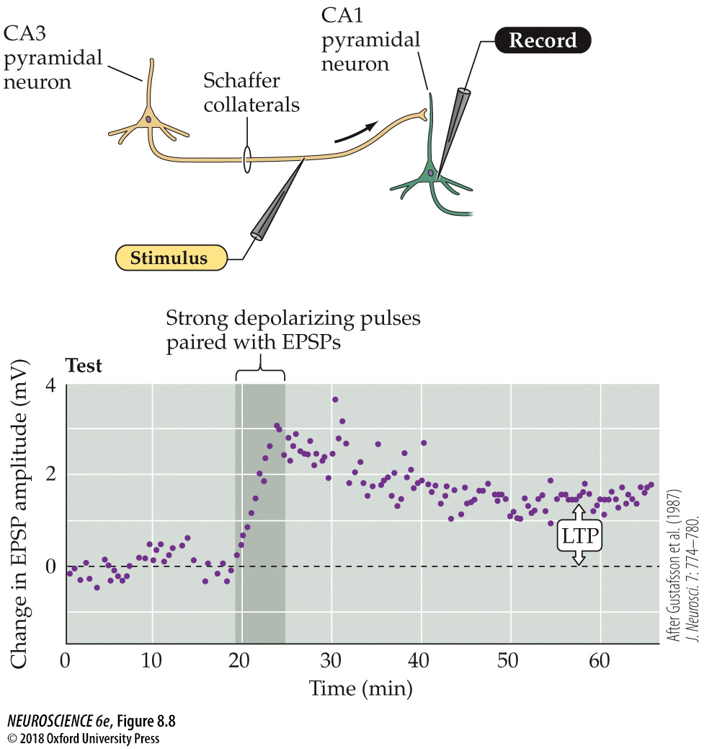
Pairing presynaptic and postsynaptic activity causes LTP
Notes:
FIGURE 8.8 Pairing presynaptic and postsynaptic activity causes LTP. Single stimuli applied to a Schaffer collateral synaptic input evoke EPSPs in the postsynaptic CA1 neuron. These stimuli alone do not elicit any change in synaptic strength. However, brief polarization of the CA1 neuron’s membrane potential (by applying current pulses through the recording electrode), in conjunction with the Schaffer collateral stimuli, results in a persistent increase in the EPSPs. (After Gustafsson et al., 1987.)

Slide 13
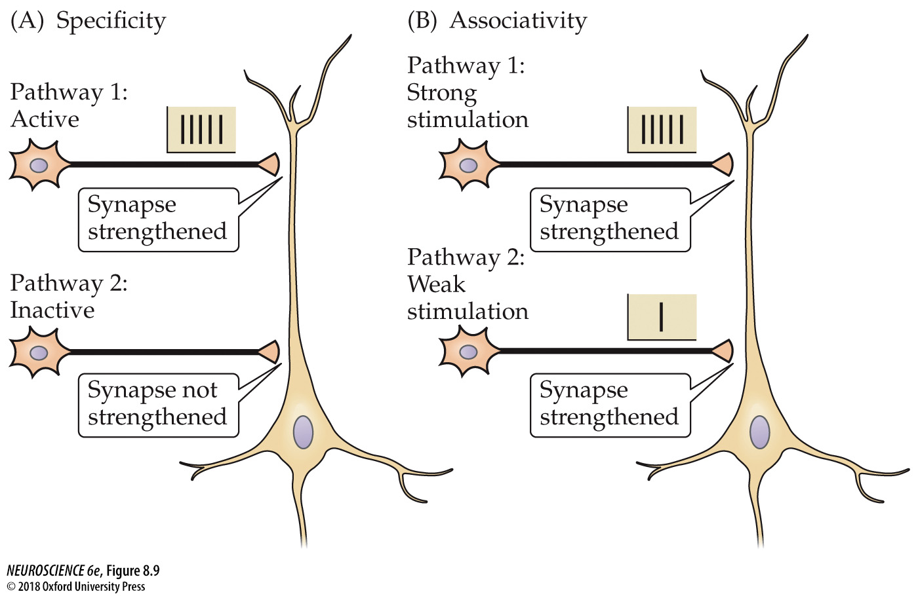
Properties of LTP at a CA1 pyramidal neuron receiving synaptic inputs from two independent sets of Schaffer collateral axons
Neurons that fire together wire together
Notes:
FIGURE 8.9 Properties of LTP at a CA1 pyramidal neuron receiving synaptic inputs from two independent sets of Schaffer collateral axons. (A) Strong activity initiates LTP at active synapses (pathway 1) without initiating LTP at nearby inactive synapses (pathway 2). (B) Weak stimulation of pathway 2 alone does not trigger LTP. However, when the same weak stimulus to pathway 2 is activated together with strong stimulation of pathway 1, both sets of synapses are strengthened.

Slide 14
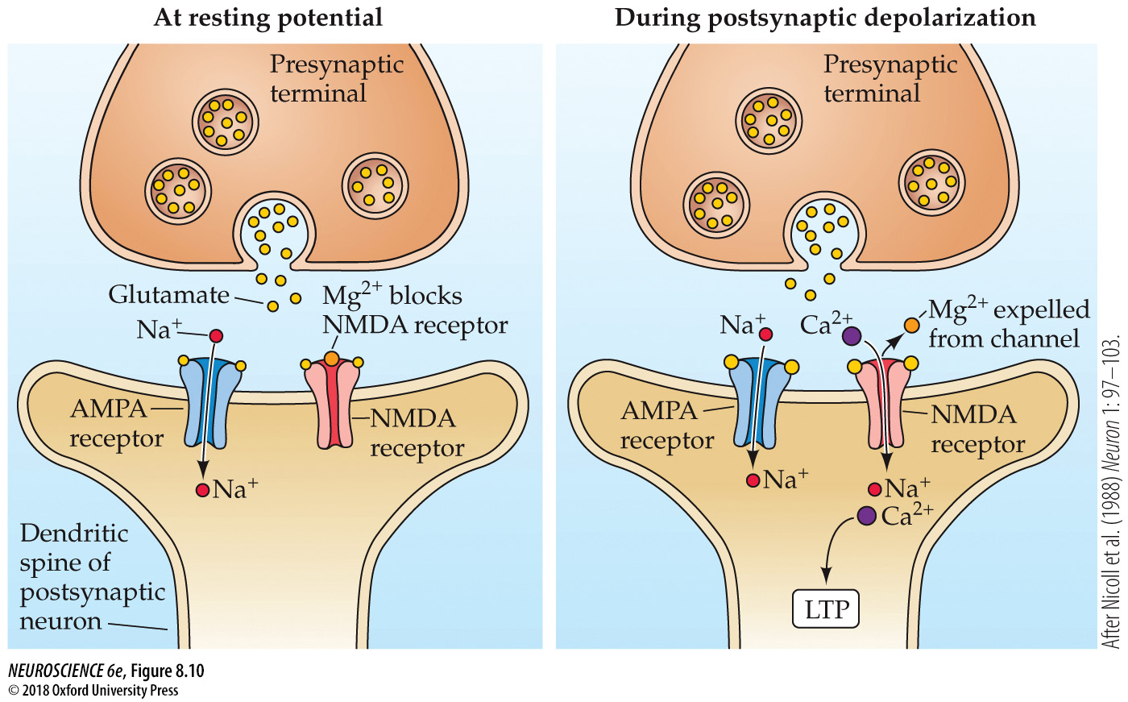
The NMDA receptor channel can open only during depolarization of the postsynaptic neuron from its normal resting potential
Notes:
FIGURE 8.10 The NMDA receptor channel can open only during depolarization of the postsynaptic neuron from its normal resting potential. Depolarization expels Mg²⁺ from the NMDA channel, allowing current to flow into the postsynaptic cell. This leads to Ca²⁺ entry, which in turn triggers LTP. (After Nicoll et al., 1988.)

Slide 15
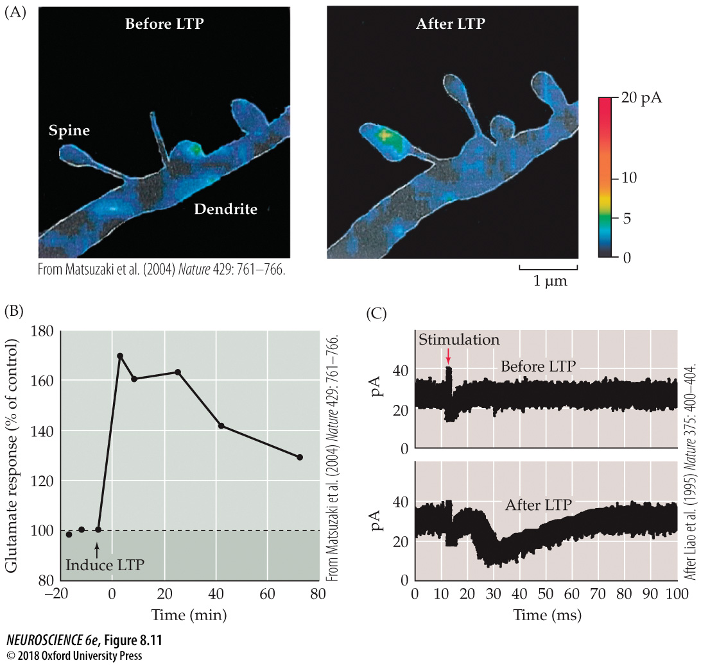
Addition of postsynaptic AMPA receptors during LTP
Notes:
FIGURE 8.11 Addition of postsynaptic AMPA receptors during LTP. (A) Spatial maps of the glutamate sensitivity of a hippocampal neuron dendrite before and 120 minutes after induction of LTP. The color scale indicates the amplitude of responses to highly localized glutamate application. LTP causes an increase in the glutamate response of a dendritic spine due to an increase in the number of AMPA receptors on the spine membrane. (B) Time course of changes in glutamate sensitivity of dendritic spines during LTP. Induction of LTP at time = 0 causes glutamate sensitivity to increase for more than 60 minutes. (C) LTP induces AMPA receptor responses at silent synapses in the hippocampus. Prior to inducing LTP, no excitatory postsynaptic currents (EPSCs) are elicited at –65 mV at this silent synapse (upper trace). After LTP induction, the same stimulus produces EPSCs that are mediated by AMPA receptors (lower trace). (A,B from Matsuzaki et al., 2004; C after Liao et al., 1995.)

Slide 16
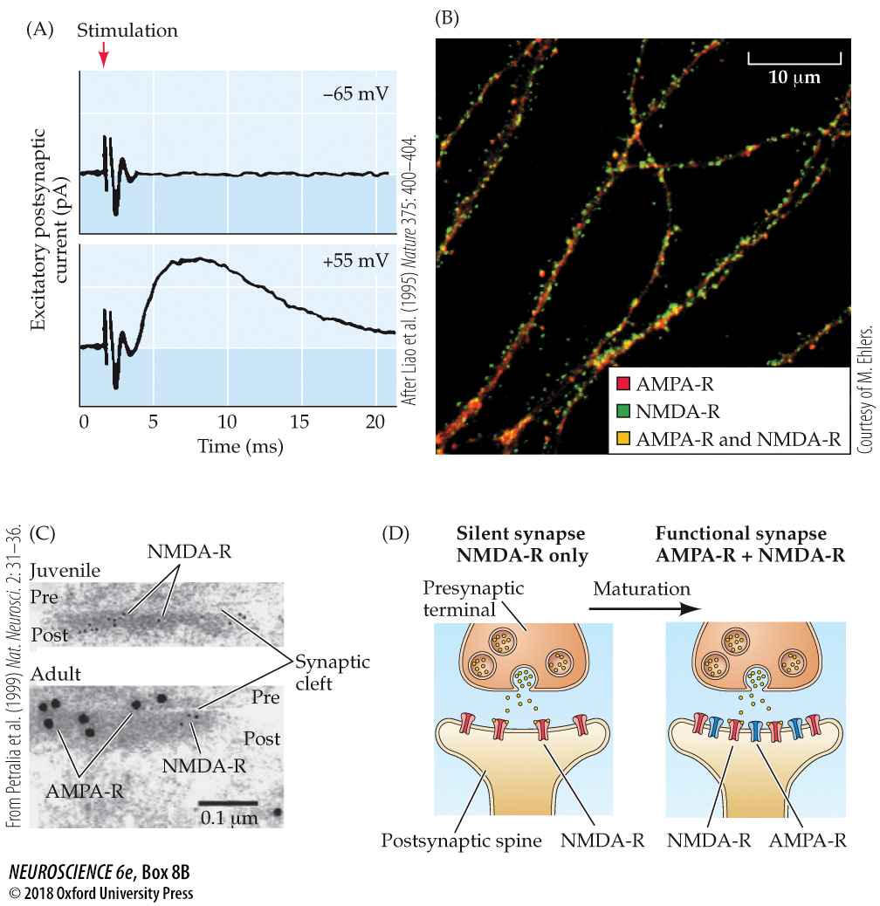
Silent Synapses
Notes:
Box 8B Silent Synapses
(A) Electrophysiological evidence for silent synapses. Stimulation of some axons fails to activate synapses when the postsynaptic cell is held at a negative potential (–65 mV, upper trace). However, when the postsynaptic cell is depolarized (+55 mV, lower trace), stimulation produces a robust response. (B) Immunofluorescent localization of NMDA receptors (green) and AMPA receptors (red) in a cultured hippocampal neuron. Many dendritic spines are positive for NMDA receptors but not AMPA receptors, indicating NMDA receptor-only synapses. (A after Liao et al., 1995; B courtesy of M. Ehlers.) (C) Electron microscopy of excitatory synapses in CA1 stratum radiatum of the hippocampus from 10-day-old (juvenile) or 5-week-old (adult) rats double-labeled for AMPA receptors and NMDA receptors. The presynaptic terminal (pre), synaptic cleft, and postsynaptic spine (post) are indicated. AMPA receptors are abundant at the adult synapse but are absent from the younger synapse. (D) Diagram of glutamatergic synapse maturation. Early in postnatal development, many excitatory synapses contain only NMDA receptors. As synapses mature, AMPA receptors are recruited. (C from Petralia et al., 1999.)

Slide 17
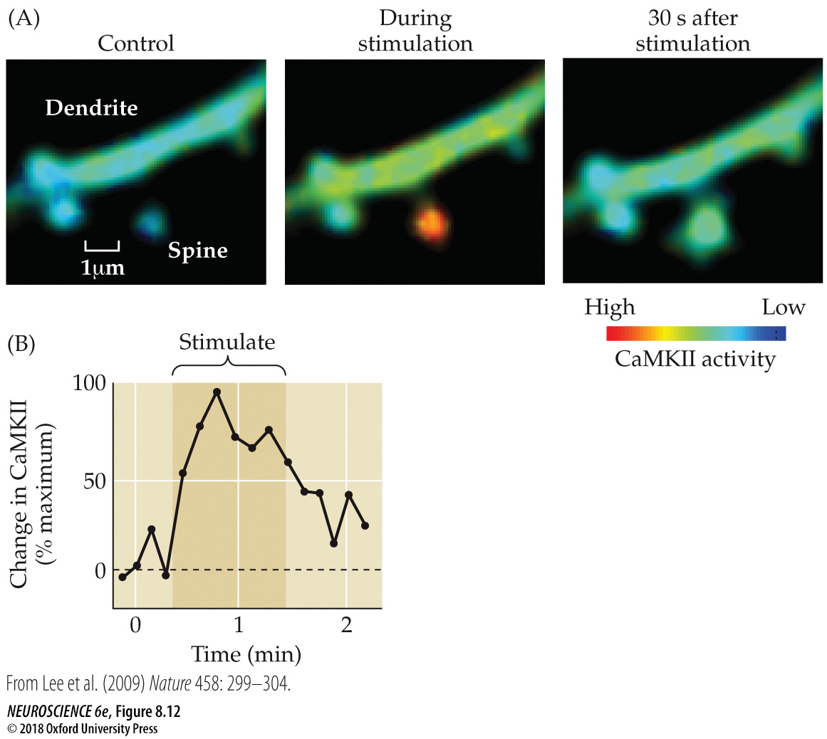
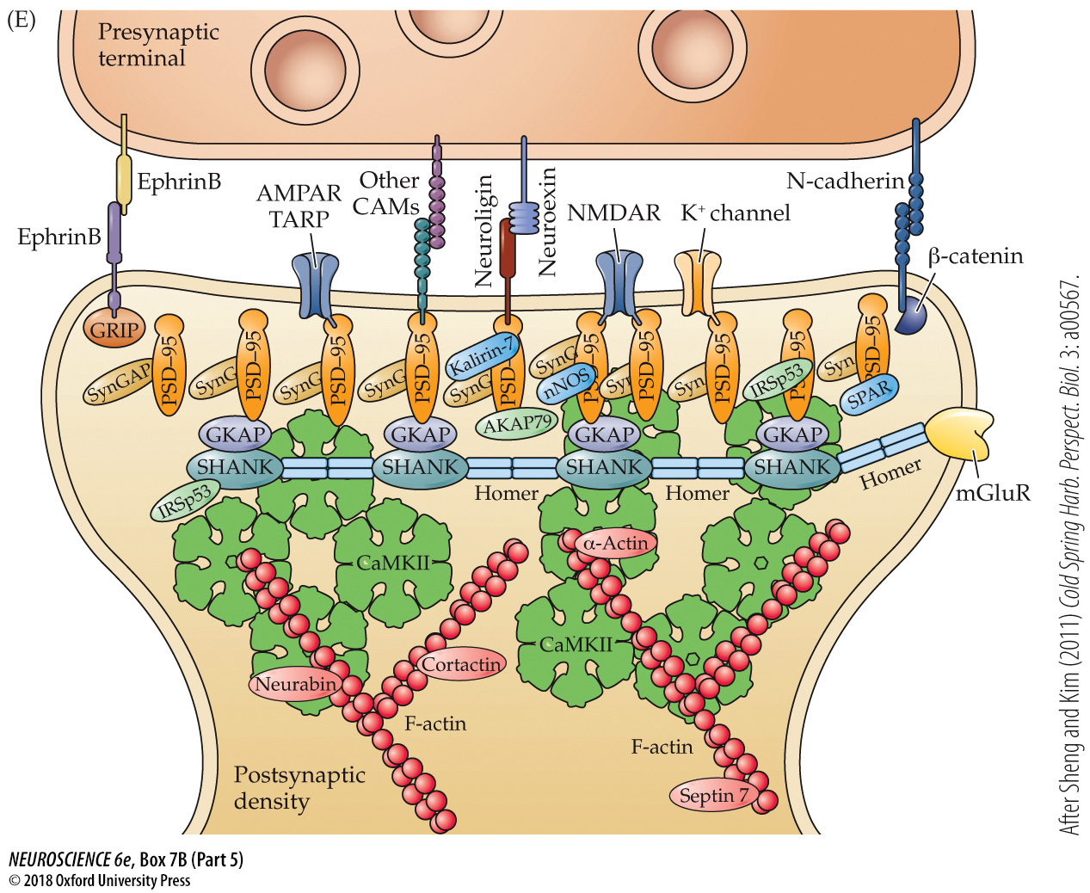
FIGURE 8.12 CaMKII activity in the dendrite of a CA1 pyramidal neuron during LTP
Notes:
FIGURE 8.12 CaMKII activity in the dendrite of a CA1 pyramidal neuron during LTP. (A) The degree of CaMKII activation (indicated by the pseudocolor scale below) in a dendritic spine dramatically increases during stimulation that induces LTP. (B) Time course of transient changes in CaMKII activity associated with LTP. (From Lee et al., 2009.)

Slide 18
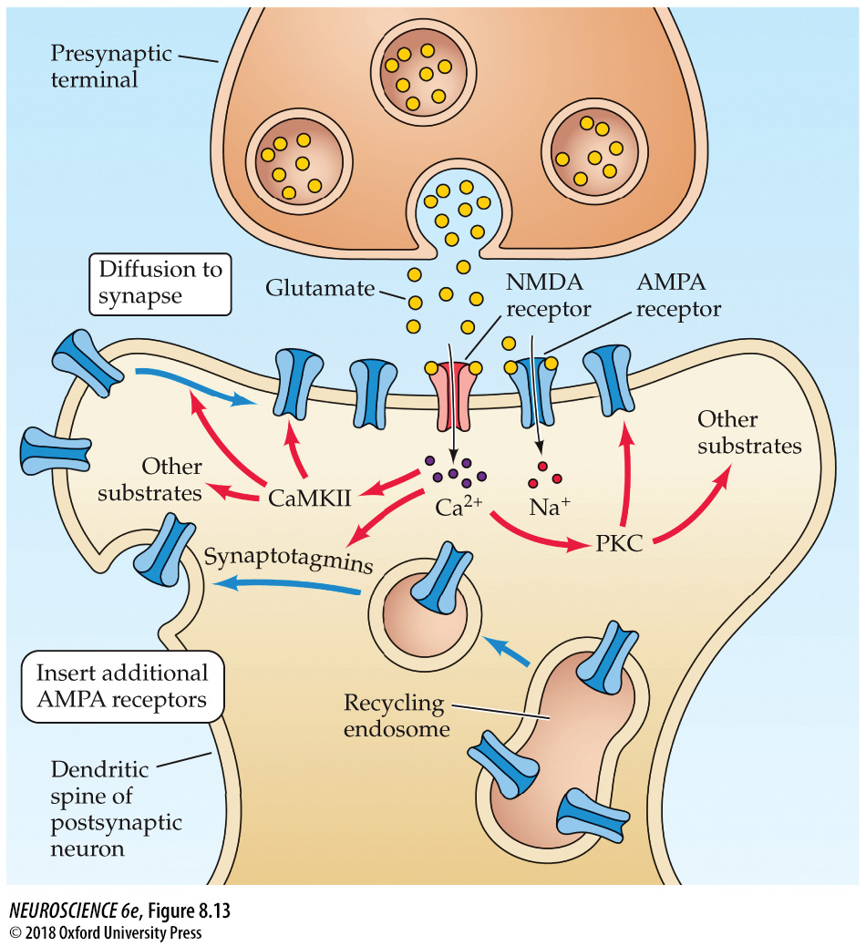
Signaling mechanisms underlying LTP
Notes:
FIGURE 8.13 Signaling mechanisms underlying LTP. During glutamate release, the NMDA receptor channel opens only if the postsynaptic cell is sufficiently depolarized. The Ca²⁺ ions that enter the cell through the channel activate postsynaptic protein kinases, such as CaMKII and PKC, that trigger a series of phosphorylation reactions. These reactions regulate trafficking of postsynaptic AMPA receptors through recycling endosomes, leading to insertion of new AMPA receptors into the postsynaptic spine. Subsequent diffusion of AMPA receptors to the subsynaptic region yields an increase in the spine’s sensitivity to glutamate, which causes LTP.

Slide 19
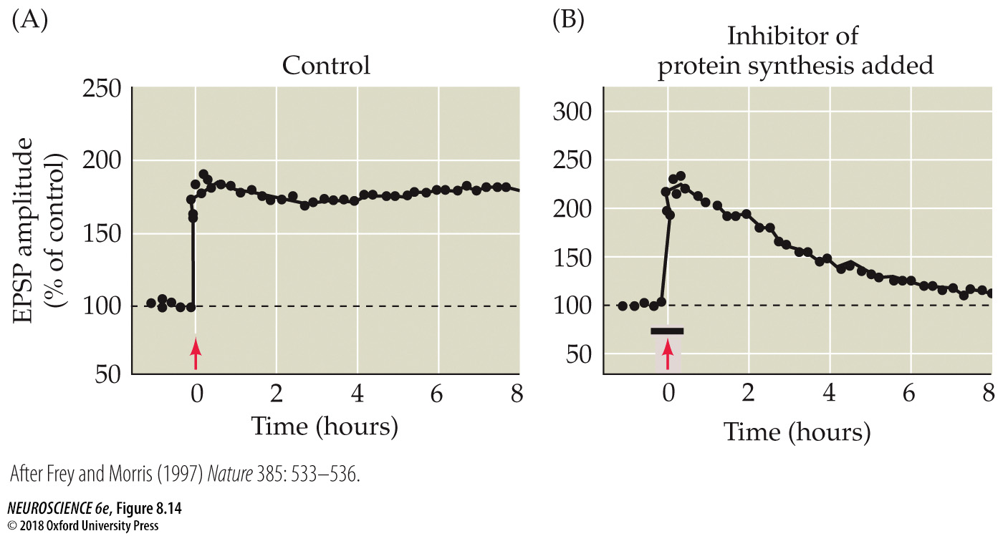
Role of protein synthesis in maintaining LTP
Notes:
FIGURE 8.14 Role of protein synthesis in maintaining LTP. (A) Repetitive high-frequency stimulation (arrow) induces LTP that persists for many hours. (B) Treatment with anisomycin (at bar), an inhibitor of protein synthesis, causes LTP to decay within a few hours after the high-frequency stimulation (arrow). (After Frey and Morris, 1997.)

Slide 20
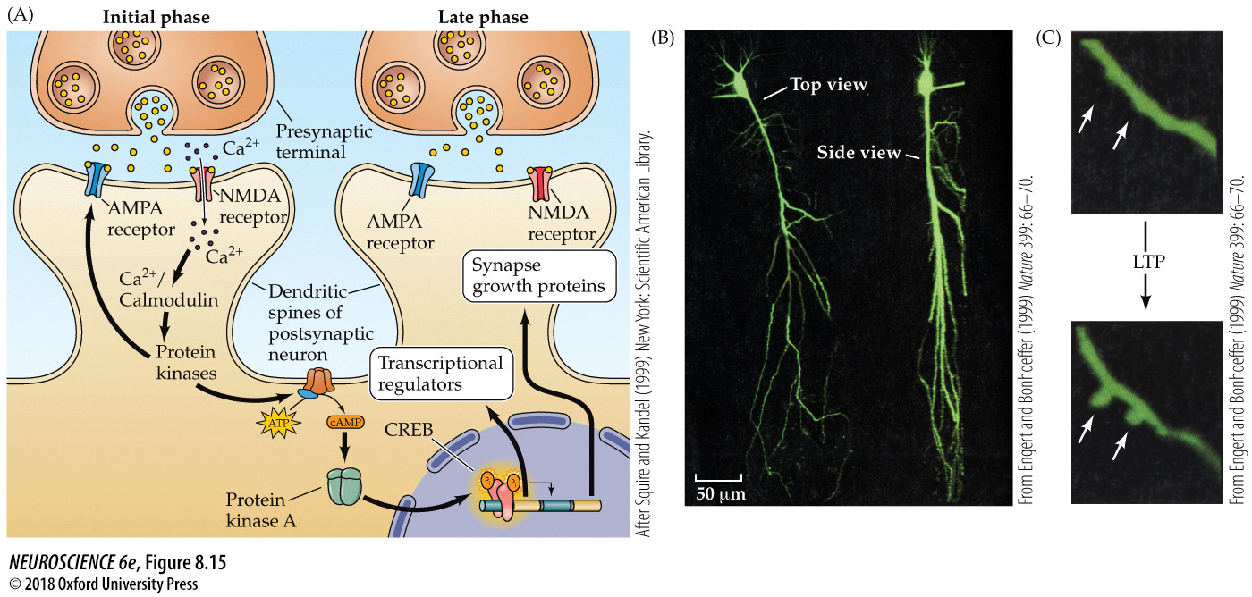
Mechanisms responsible for long-lasting changes in synaptic transmission during LTP
Growth of new dendritic spines
Notes:
FIGURE 8.15 Mechanisms responsible for long-lasting changes in synaptic transmission during LTP. (A) The late component of LTP is the result of PKA activating the transcriptional regulator CREB, which turns on expression of several genes that produce long-lasting changes in PKA activity and synapse structure. (B,C) Structural changes associated with LTP in the hippocampus. (B) The dendrites of a CA1 pyramidal neuron were visualized by filling the cell with a fluorescent dye. (C) New dendritic spines (white arrows) can be observed approximately 1 hour after a stimulus that induces LTP. The presence of novel spines raises the possibility that LTP may arise, in part, from formation of new synapses. (A after Squire and Kandel, 1999; B and C after Engert and Bonhoeffer, 1999.)

Slide 21
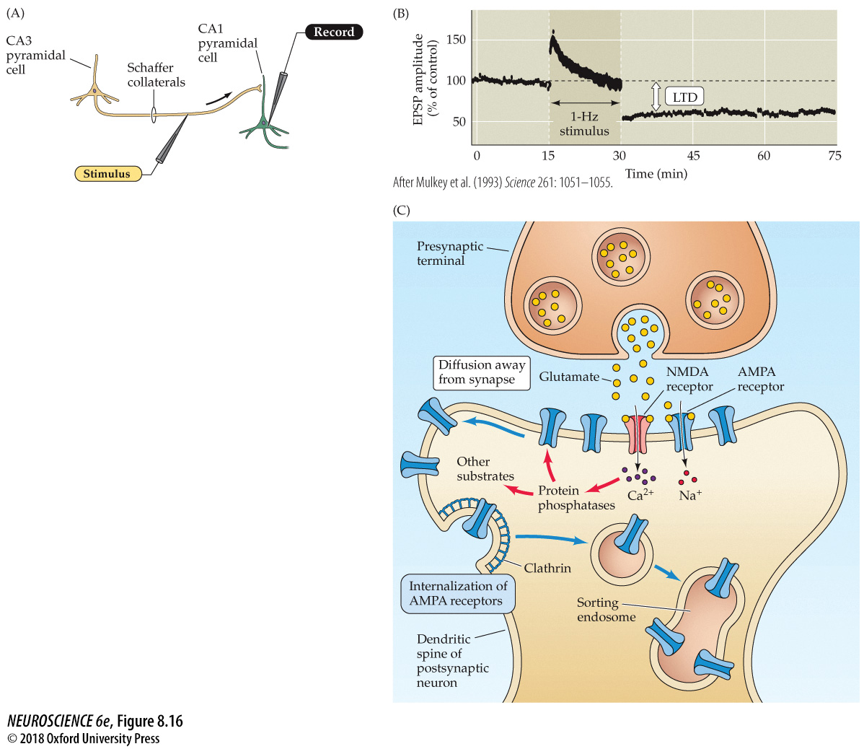
Long-term synaptic depression in the hippocampus
Eradication of memories
Notes:
FIGURE 8.16 Long-term synaptic depression in the hippocampus. (A) Electrophysiological procedures used to monitor transmission at the Schaffer collateral synapses on CA1 pyramidal neurons. (B) Low-frequency stimulation (one per second) of the Schaffer collateral axons causes a long-lasting depression of synaptic transmission. (C) Mechanisms underlying LTD. A low-amplitude rise in Ca²⁺ concentration in the postsynaptic CA1 neuron activates postsynaptic protein phosphatases, which cause internalization of postsynaptic AMPA receptors, thereby decreasing the sensitivity to glutamate released from the Schaffer collateral terminals. (B after Mulkey et al., 1993.)

Slide 22
Signaling at cerebellar parallel fiber synapses during long-term synaptic depression
Cerebellar Purkinje cell is different
Notes:
FIGURE 7.14 Signaling at cerebellar parallel fiber synapses during long-term synaptic depression. Glutamate released by parallel fibers activates both AMPA-type and metabotropic receptors. The latter produce IP₃ and DAG in the Purkinje cell. When paired with a rise in Ca²⁺ associated with activity of climbing fiber synapses, the IP₃ causes Ca²⁺ to be released from the endoplasmic reticulum, while Ca²⁺ and DAG together activate protein kinase C. These signals together change the properties of AMPA receptors to produce long-term depression.

Slide 23
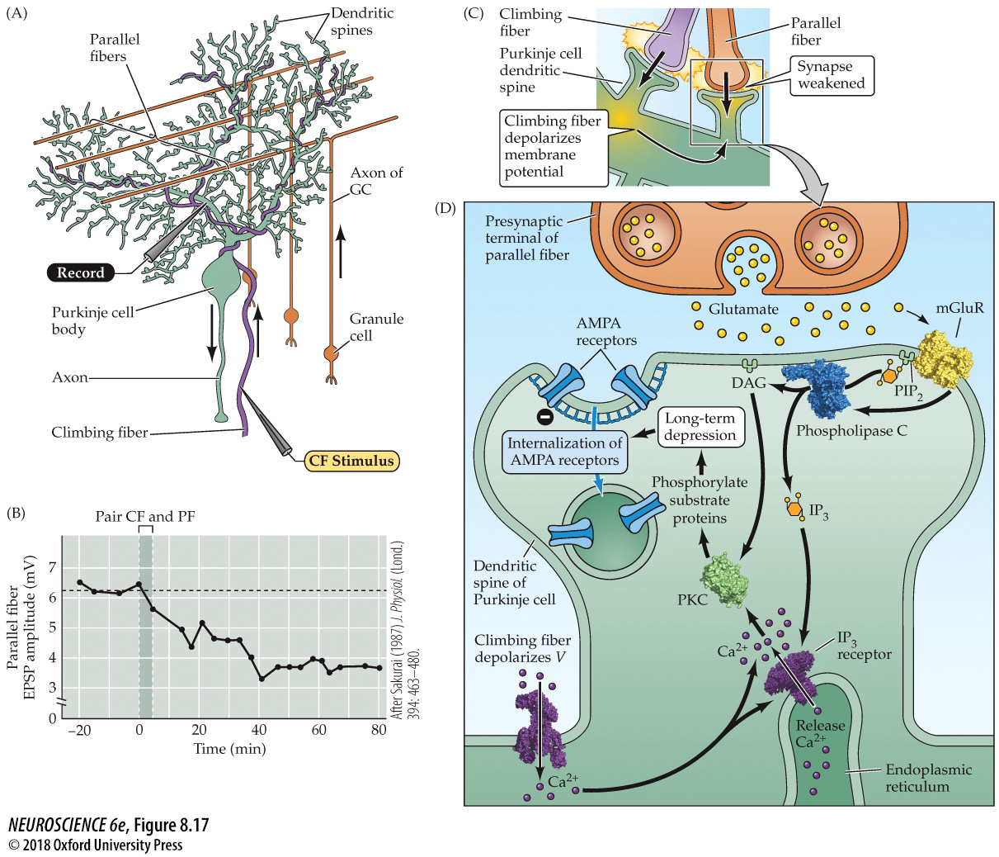
Long-term synaptic depression in the cerebellum
Notes:
FIGURE 8.17 Long-term synaptic depression in the cerebellum. (A) Experimental arrangement. Synaptic responses were recorded from Purkinje cells following stimulation of parallel fibers and climbing fibers. (B) Pairing stimulation of climbing fibers (CF) and parallel fibers (PF) causes LTD that reduces the parallel fiber EPSP. (C) LTD requires depolarization of the Purkinje cell, produced by climbing fiber activation, as well as signals generated by active parallel fiber synapses. (D) Mechanism underlying cerebellar LTD. Glutamate released by parallel fibers activates both AMPA receptors and metabotropic glutamate receptors (mGluRs). The activated mGluRs produce two second messengers, DAG and IP₃, which interact with Ca²⁺ that enters when climbing fiber activity opens voltage-gated Ca²⁺ channels. The resultant release of Ca²⁺ from the endoplasmic reticulum leads to a further rise in intracellular Ca²⁺ concentration and the activation of PKC, which triggers clathrin-dependent internalization of postsynaptic AMPA receptors, weakening the parallel fiber synapse. (B after Sakurai, 1987.)

Slide 24
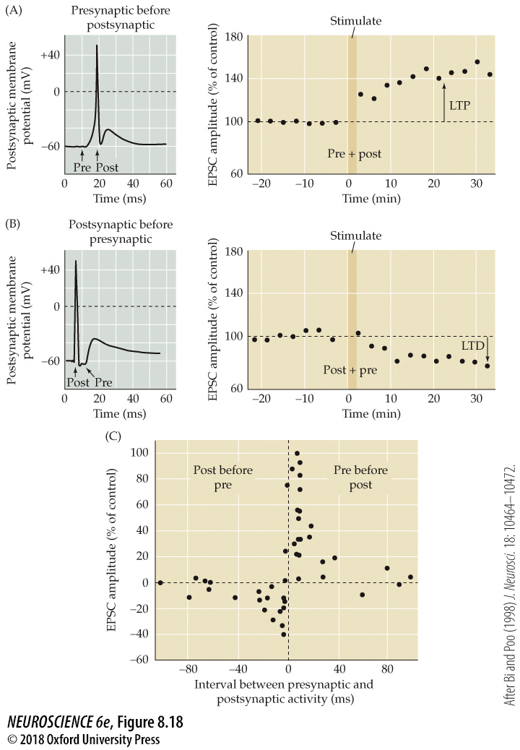
FIGURE 8.18 Spike timing-dependent synaptic plasticity in cultured hippocampal neurons
Coincidence leads to LTP
Separation gives LTD
Notes:
FIGURE 8.18 Spike timing-dependent synaptic plasticity in cultured hippocampal neurons. (A) Left: Stimulating a presynaptic neuron (Pre) causes an EPSP in the postsynaptic neuron; applying a subsequent stimulus to the postsynaptic neuron (Post) causes an action potential that is superimposed on the EPSP. Right: Repetitive application of this stimulus paradigm causes LTP of the EPSP. (B) Reversing the order of stimulation, so that the postsynaptic neuron is excited before the presynaptic neuron, causes LTD of the EPSP. (C) Complex dependence of STDP on the interval between presynaptic activity and postsynaptic activity. If the presynaptic neuron is activated 40 milliseconds or less before the postsynaptic neuron, then LTP occurs. Conversely, if the postsynaptic neuron is activated 40 milliseconds or less before the presynaptic neuron, LTD occurs. If the interval between the two events is longer than 40 milliseconds, no STDP is observed. (After Bi and Poo, 1998.)

